Slide 1
Prof. Bruno Pierri History of Italian Foreign Policy
Italian Foreign Policy: A Historiographical Analysis, 1860-1922
January 28th, 2015

Slide 2
France vs Italy
Harold Nicolson, British Diplomat, 1939:
Rigid French Diplomacy vs Italian mobile diplomacy
Italian diplomacy system based on Renaissance traditions, based neither on business, nor on power-policy. It is based on ongoing manouvre
While Germany bases diplomacy on power, Italy bases power on diplomacy: to gain importance through negotiation rather than strength.
While France secures permament allies against permanent enemies, Italy regars allies and enemies as interchangeable.
While UK seeks durable credit, Italy seeks immediate advantage. While UK opposes any country aiming at dominating Europe, Italy wants to be tilt of scale
Italian art of negotiation, creating bad relations with countries she wants to negotiate with, then offering good relations, asking concessions Italy does not expect to obtain, in order to abandon them and obliging the interlocutor to pay some compensation
Italy combines pretentions of Great Power with methods of Small Power

Slide 3
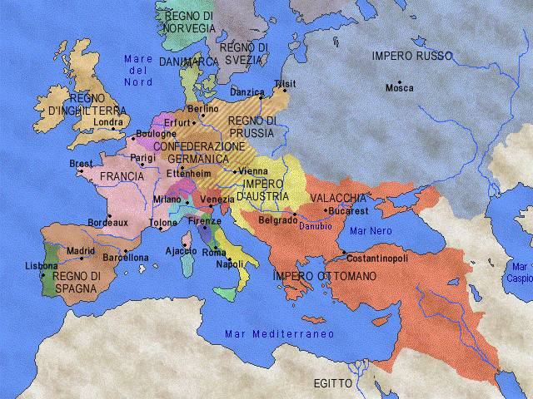

Slide 4
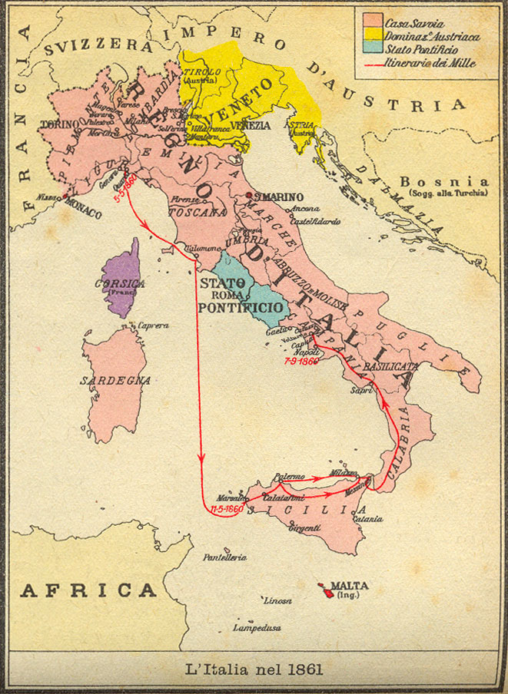

Slide 5
Outcome of Risorgimento
Unlike European State nations, in Italy a nation emerged where none had been before, with pretty new frontiers
Two per cent of the population with right to vote, half of whom catholic with no opinion of their own
Liberal system with constitution
Capitalist economy
Could the country with smallest population, least developed economy, most vulnerable strategic position and largest gap between politics and society hold a place among Great Powers?
Italy was a country necessarily embracing diplomacy. Italy could only exist while having a foreign policy
First foreign policy aim: Cavur - seizing “Italian” territories still in foreign hands (Istria, Trentino, Corsica, Malta, Dalmatia, Ticino)

Slide 6
Parity with European Powers
Nationality principle as a pillar of Italian foreign policy up to WW1
Once accepting European diplomacy and concert of States, Italy claims equal relationship
Parity in Europe as main theme of Italian policy: concert of nations, League of Nation, United Nations, NATO, EU
Very soon attention was turned to Mediterranean and Balkan-Danube area

Slide 7
Politica del Carciofo
Artichoke policy: one leaf at a time
U. Rattazzi: “Pacification” of the South as “school” for Africa
Crispian African adventures
Public opinion played a minimal role, while in Germany pressure groups soon shaped a popular basis to foreign policy

Slide 8
Vatican
Italy unified against a sea of enemies
For the first three of four decades, the Vatican was one of the worst foes of the Liberal regime

Slide 9
Balkans
Some urged Serbia and Greece to assume the mantle of Piedmont in the region
Some sought economic influence
Some regarded Albania as foundation stone of Italian empire

Slide 10
Austria
Public enemy number one for both irredentists and imperialists
Until 1916, Austria had been the only European power to which Italy had ever declared war
At the same time, since 1882 Austria had been an ally in the Triple Alliance
Triple alliance necessary to preserve status quo (Central Powers as champions of conservatism) and oriented to public enemy number two

Slide 11
Giving up neutrality
Rivalry with France and risk of invasion of Sicily
Austrian-Hungarian Empire might expand Eastwards, with relative strengthening in Adriatic
Hope that, in case of alliance, Austria might cede Trentino
In case of war between Russia and Turkey, Britain would have backed the former
Neutrality could have been turned into isolation

Slide 12
Getting closer to Germany
1877 Crispi (Chairman of House of Deputies) got in touch with Bismarck to propose alliance in case of war against both France and Austria
Integrity of Austrian Empire matched European balance and German interests
Italian proposal rejected: Bismarck did not back Italian irredentism and wished Italo-Austrian friendship

Slide 13
Berlin Congress 1878
Austria occupied Bosnia-Herzegovina and improved positions in Dalmatia
Britain kept Cyprus
France got free hand in Tunisia
Russia gained Bessarabia and Batum, on Black Sea
Germany had no territorial gains, but became main stay of European balance

Slide 14
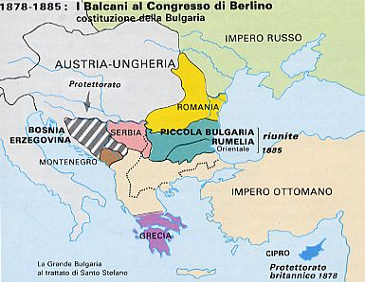

Slide 15
Repercussions in Italy
No gain for Italy
Agreements reached before Congress
Italy excluded since she was not part of any alliance
May 12, 1881: French Protectorate on Tunisia without any compensation and guarantee to Italian interests
British tacit assent to French interests
Italy completely isolated and diplomatically powerless
Necessity of alliance on anti-French purposes

Slide 16
Triple Alliance 1882
Italian committment to assist Germany in case of unprovocked French aggression
Austrian and German committment to assist Italy in case of unprovocked French aggression
Casus foederis: in case one or two parties involved in war, without any provocation, against two or more powers – I.e. if Austria attacked by Russia and France, Italy obliged to intervene
In case of war against power due to threat, the other parts observed benevolent neutrality towards allies, reserving themselves to intervene on her side
Committment not to undertake any other alliance hostile to Triple Alliance and to consult the other parts on political and economic matters
Accomplishment of Bismarck diplomacy: isolation of France, surrounding of Germany avoided, European system rotating around Germany

Slide 17
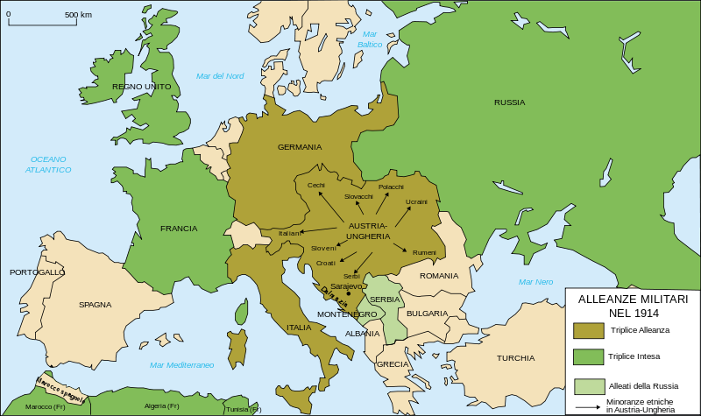

Slide 18
France
Latin sister/step sister
While Piedmont expanded into Italy, Cavour had surrendered Nice and Savoy to France
While Nice, Savoy or Marseilles did not possess strategic importance of Trento and Trieste, conflict with France was also ideological:
Republican France might soccour democrats in Italy
Catholic France might befriend the Pope
Intellectual France might claim cultural superiority
Financial and commercial France might dominate Italian economy
Imperial rivalry with France

Slide 19
France
Tunisian Question:
Treaty undersigned with Bey – Lord of Tunis, formally vassal of Sublime Porte, but practically widely self-governing – in Sept 1868 safeguarded Italians living there; Italy to benefit status of most favoured nation on economic level, as well as France
In order to divert French attention from revanschism against Prussia, Bismarck persuaded them to concentate on different aims
Bismarck felt this would bring a double advantage to Germany
distract France from plans of revanche in Europe
France clashed with Britain and Italy over the African question
While France remained hostile towards Britain, she could not fight in Europe, and an offended Italy would seek support in Germany and Austria-Hungary
Tunisia became French protecorate (1881) with great Italian displeasure
This ended up to favour Austrian and German interests

Slide 20
Italian Claims
Taking advantage of France’s defeat in the war against Prussia, Italy attempted to impose an agreement on Tunisia, which envisaged special privileges for the Italian residents
The Bey decided to resist. The Italians then began to prepare a naval expedition against Tunisia and only a joint British, French and Turkish demarche forced them temporarily to relinquish their plans
French capitalists became more and more persistent in demanding Tunisia’s complete conversion from a semi-colony into a French colony
Tunisia’s annexation was raised at the Berlin Congress in 1878. France agreed to recognise the British and Austrian conquests (Cyprus and Bosnia-Herzegovina), and also Russia’s expansion in the Balkans, under the condition that she be given the appropriate compensation

Slide 21
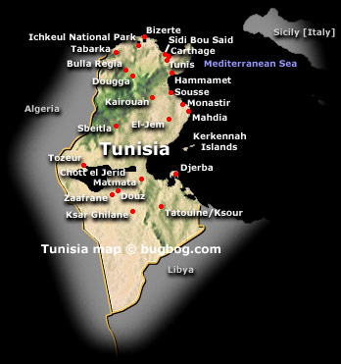

Slide 22
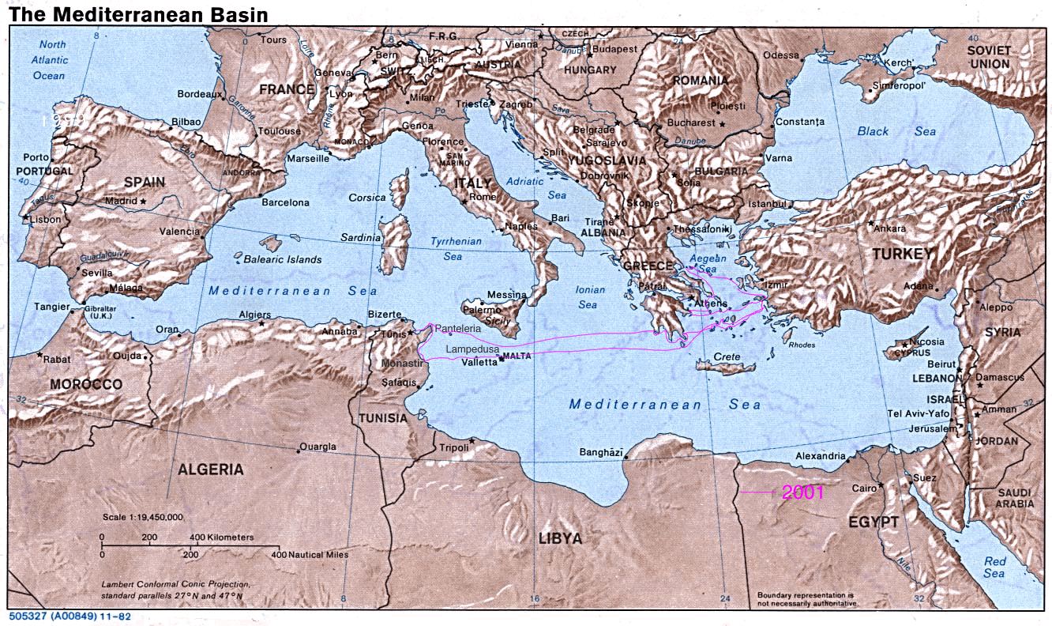

Slide 23
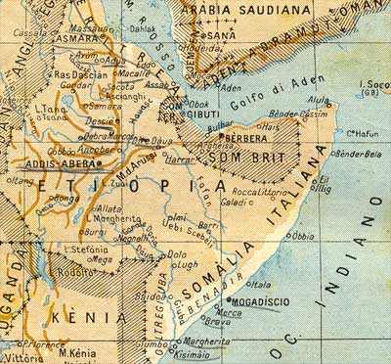

Slide 24
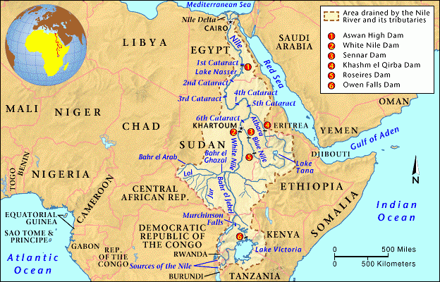

Slide 25
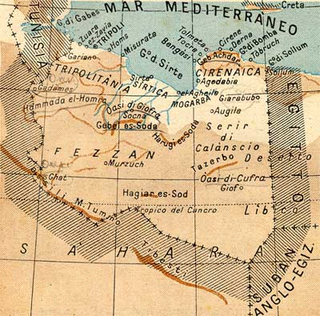

Slide 26
Alliances
France acquired Britain as an ally in 1904
Austria had acquired Germany as an ally in 1879
Italian finance had becaome client of German expertise after the Scandal of Banca Romana
Banca Romana 1893: a deficiency of cash, cooked accounts, a great quantity of bad debts due to speculation in building. Politicians had received money to finance their election expenses and to run or bribe newspapers

Slide 27
Bismarck’s Diplomacy
Anti-German coalition avoided
St. Petersburg and Vienna divided on Eastern question
France tried to break isolation and reconquer a position of power, thus weakening Germany
Twofold Alliance Austria-Germany 1879
Three Emperors Pact 1881 (Germany-Austria-Russia): Bismarck sought peace between Austria and Russia, at the same time avoiding approach between Russia and France
Through Triple Alliance, though without any explicit reference to safety of borders, Italy was relieved from territorial worries and Austrian support to French clericalism

Slide 28
Entente Cordiale
Germany disliked Italian diplomacy since Italy was trying to rapproach France
Berlin aimed at keeping intact Triple Alliance as a challenge and defence against Anglo-French Entente Cordiale 1904
Colonial controversies sorted out: Britain free hand in Egypt, France free hand in Morocco

Slide 29
Franco-British Declaration, 1904
His Britannic Majesty's Government declare that they have no intention of altering the political status of Egypt
The Government of the French Republic declare that they will not obstruct the action of Great Britain in that country
The Government of the French Republic declare that they have no intention of altering the political status of Morocco
His Britannic Majesty's Government recognise that it appartains to France to preserve order in that country, and to provide assistance for the purpose of all administrative, economic, financial , and military reforms

Slide 30
Secret Articles
In the event of their considering it desirable to introduce in Egypt reforms tending to assimilate the Egyptian legislative system to that in force in other civilised Countries, the Government of the French Republic will not refuse to entertain any such proposals, on the understanding that His Britannic Majesty's Government will agree to entertain the suggestions that the Government of the French Republic may have to make to them with a view of introducing similar reforms in Morocco

Slide 31
Britain
Despite claims on Malta and Eastern Mediterranean, until 1922 Italy had no real anti-British stance
British naval superiority
Cities like Palermo, Naples, Genoa open to seaborn bombing and attack
After acquisition of Libya, communications with Fourth Shore could only survive on sufferance of Royal Navy
Uk exporter of coal: stranglehold over Italian energy supplies
Since Italy remained rather poor, peace, and not war, was Italy’s foreign policy purpose

Slide 32
First World War
Premier and Foreign Minister (Salandra and Sonnino) not pushed by accurate analysis of national interests, but by the chance to “enter history”
Risorgimento to be made real

Slide 33
Domestic influence
Giolitti believed that Italy could avoid participating in great power policy game, though eventual defeats would make Liberal regime collapse
Italy laid in heart of Europe. Unlike Sweden or Spain, she could not ignore European quarrels

Slide 34
War and social classes
Peasantry saw the worst evils of the war
Working class in general rejected the war, though some moderale Socialis leaders (Turati) favoured a policy of “neither support, nor sabotage”
Revolutionary leaders, like Mussolini, saw war as their historic moment and abandoned official Socialism
Catholics preferred Italy to stay out of war
King did not want war
Industrialists saw opportunities of profit both from neutrality and from combat
Freemasonry did not automatically opted for war
1914 Giolitti: Italy to enter war only after it was absolutely clear who was winning, and and get ready to deal with embittered losers in post-war settlements
In 1915 Salandra sensed that time was running out

Slide 35
War Gains
Italy achieved basic war aims: Alto-Adige, Trieste, Trento, Istria: border reached Alpine watershed with Germanic and Slav peoples
Austro-Hungary disappeared from map

Slide 36
Italian Interests
Italy wanted territorial compensations in case of Austrian enlargement also in non Ottoman lands, such as Serbia and Montenegro
Protocol of Triple Alliance provided agreement on Balkans
Italy aimed at Italian provinces of Austria and parts of Adriatic coast
Austria did not respond to Italian pressures, thus making Italian entry into war impossible
3.8.1914: statement of Italian neutrality
Vienna ready to accept Italian claims, but not those relating to Balkans

Slide 37
Treaty of London
PM Salandra: sacred sefishness must be guide for Italy
2.3.1915: beginning of secret negotiations with Entente
Anglo-French progresses against Turkey decisive for Italian decision to join war effort: in case of Turkish defeat, Asia Minor questions would have involved also Adriatic area
Telegram to Italian Ambassador to London: «Italian Govt, for reasons of loyalty to Austria and Germany, wish to keep scrict neutrality, but in light of threats which may derive from a changed territorial asset in the Balkans, Adriatic, and in general European and Mediterranean area, as well as the threat coming from German and Austrian resentment due to Italian neutrality, think it possible to join British, French and Russian war effort. However, for economic reasons this option must be necessarily followed by a series of guarantees...»
26.04.1915 Italy to join war within a month with Entente, in exchange of, in case of victory, Trentino, Southern Tirol, Venezia Giulia, Istria except Fiume, part of Dalmatia, several isles in Adriatic, Vlona and Saseno in Albania, coal fields in Turkey. Territorial compensations in Africa to detriment of German colonies. Italian committemnt to fight with Britain, France and Russia aganinst all of their enemies

Slide 38
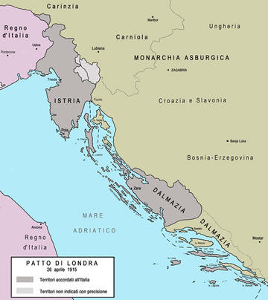

Slide 39
War Diplomacy
24.05.1915 Italy joins war
Rome never regarded with equal dignity within Entente
Different psychological perception of war: for allies real enemy was German militarism. Austria to collapse afterwards; for Italy historical enemy was Austria
Declaration of War to Turkey without sending in any troops
No declaration of war to Germany until Aug 1916
No real committment in Balkans
Allies did not inform Italy on cession to Russia of Costantinoples and Straits and partition of Ottoman territories in Middle East

Slide 40
War Aims
Entente thought Italy had been already widely compensated in Adriatic
Rome wanted compensations in Asia Minor and Middle East
February Revolution in Russia weakened Russian committment: allies obliged to satisfy Italy:
Smirne and hinterland in Asia Minor included into Italian sphere of influence, after Russian assent
End of projects of any separate peace with Austria

Slide 41
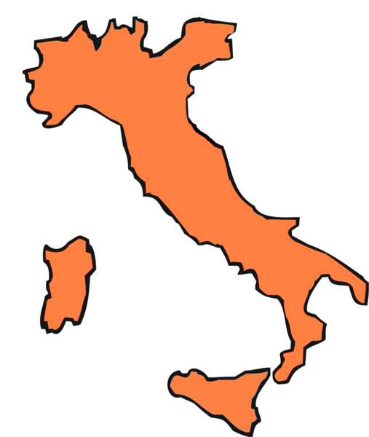

Slide 42
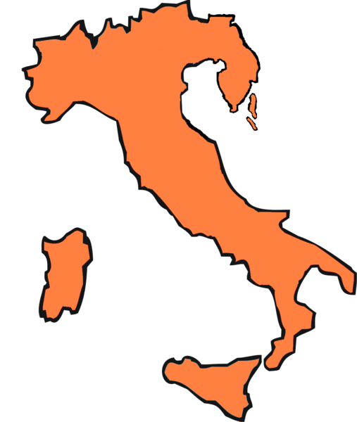

Slide 43
Mutilated Victory
Caporetto meant that foreigners would always dismiss Italy’s skills in the most insulting way
Formal powers in war had rested in hands of Salandra and Sonnino, and then V. Emanuele Orlando
Sacro egoismo vs Wilsonian liberal capitalist diplomacy

Slide 44
United States at War
1917 Wilson: democratic peace and self-determination of peoples
Kingdom of Serbia-Croatia-Slovenia (Greater Serbia no longer possible due to Russian defeat)
Italian programmes overcome by these two events
Bolscevicks published text of Treaty of London
Interventionist left wing in Italy claimed agreements with Slavs, thus respecting Wilsonian design

Slide 45
The fourteen points
Wilson 8 Jan 1918
Peace without winners, since peace imposed through force would include elements of another war
Peace based on equality of nations, self-determination of peoples, freedom of seas, general reduction of armaments
Secret Diplomacy had to be abandoned
Nationality Principle - “self-determination of peoples" -: implemented above all in Eastern Europe and Middle East, in order to fill the vacuum left by simultaneous collapse of multi-ethnic empires
Point 9. Change of Italian frontiers according to clearly recognizable demarcation lines among nationalities
Italian diplomats completely alien from this kind of foreign policy

Slide 46
Peace Conference
V.E. Orlando – Three obstacles for Italy: allies, Wilson and Jugoslavs
Allies recognised Brennero border
No concession on Fiume and more than half Istria
Wilson thought Italian safety could be assured by League of Nations
Italians appealed to sanctity of pacts to legitimise claims on Slav lands and to nationality principle to claim Fiume
Wilson appealed to people on Apr 23:
Treaty of London only a private agreement
Austro-Hungarian Empire no longer existed
Extension to Dalmatia not necessary
Hope for Italy not to ask for any compensations contrary to liberal principles

Slide 47
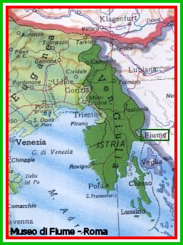

Slide 48
Treaty of Rapallo
1920: Republicans in US back to power and isolationism
Italo-Jugoslav Treaty:
Trieste, Gorizia, Istria and some districts of Carniola annexed to Italy
Zara assigned to Italy
Free State of Fiume with territory called "Corpus separatum", within the borders of city and district of Fiume", and a further strip of territory guaranteeing territorial continuity with Italy
With Treaty of Rome Jan 1924, Fiume was annexed to Italy
With Treaty of peace of Lausanne with Turkey (1923), Italy kept Dodecannese, but colonial questions still opened, while renouncing to Asia Minor

Slide 49
Early Fascism
Mussolini financially backed through squash raids on peasant and socialist institutions.
Fascists talked a lot about foreign policy, but were led by inner interests: Primat der Innenpolitik

