Slide 1
Prof. B. Pierri History of Italian Foreign Policy
Fascist Middle Eastern Policy:
The Protector of Islam
March 17th, 2015

Slide 2
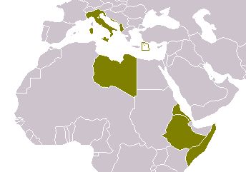

Slide 3
Fascist Aims
Proclamation of Empire May 1936
Three targets to pursue at the same time:
Make use of political developments in Middle East to put pressure on UK to recognise Italian Empire
Expand Italian influence in Middle East
Pacify Italian colonies in Africa while promoting ventures within them

Slide 4
Europe and Middle East
Italian policy on Middle East dependent on state of relations in Europe
Mussolini did not abandon anti-British stance to play role of bridge between East and West
Ethiopian war, sanctions, and Spanish civil war widened the gap between fascist regime and European democracies

Slide 5
Foreign involvement in Spanish civil war
Right wing and Catholics supporting Nationalists as a way to stop expansion of Bolshevism
On the left, including labour unions, students and intellectuals, war represented necessary battle to stop spread of Fascism
Germany sent Luftwaffe modern warplanes
Italy sent 100,000 men
Britain and France led a bloc of 27 nations that promised arms ambargo to Spain; United States unofficially went along
Germany, Italy and the Soviet Union also signed on officially, but ignored the embargo
France accused of allowing large shipments to Republican troops
Though Stalin had signed Non-Intervention Agreement, USSR contraveened League of Nations embargo by providing material assistance to Republican forces

Slide 6
Axis Rome-Berlin
Summer 1936: conciliatory statements to London and overtures to Berlin
Hitler to Ciano – October 1936: Mediterranean is an Italian sea. Any future modification of Mediterranean balance must be in Italy’s favour
Germany had no interests in Middle East. This freed Italy from potential competitor
Italy no longer interested in defence of Austria
Axis Rome-Berlin gave Mussolini free hand in devising Middle Eastern policy
Nov 1, 1936: Axis Speech
Mediterranean for Britain only a shortcut to Empire
Mediterranean for Italy is life
We do not intend to interrupt that road, but we demand that our interests be respected
Clash between powers to avoid through frank agreement and mutual recognition of interests

Slide 7
Gentlemen’s Agreement
Jan 1937 common declaration know as Gentlemen’s Agreement
Italy and Britain had equal interests in freedom of passage in Mediterranean and did not want to change status quo as regarded national sovereignty of territories
London de facto, but not de jure, recognised Italian conquest of Ethiopia
Foreign Office wanted to pursue Anglo-Italian detente, in order to gradually detach Italy from Germany
Agreement with Italy only brought military advantages, since dangerous clash on Red Sea and Suez Canal areas had been avoided
From a political point of view no real outcome, as Italy and Germany were getting closer and closer, by both intervening in Spanish War
Eden said he did not want a right wing dictatorship be replaced with left wing one. Democracy, he said, was not fit to pave the way to communism

Slide 8
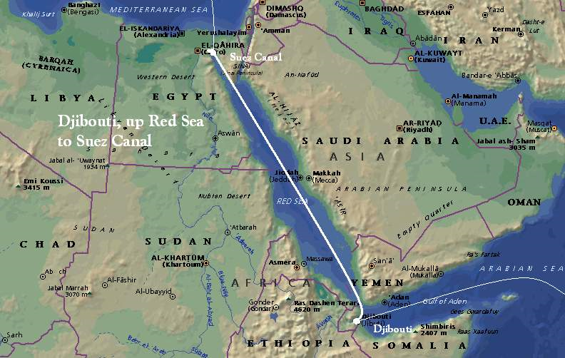

Slide 9
Easter Accords
Agreement between UK and Italy April 16, 1938
It ended the Mediterranean and Red Sea litigations and validated status quo of territorial sphere of influence in Arabia, Abyssinia and Lake Tsana
British and Italian governments undertook to observe order in the Mediterranean, to refrain from any actions against sovereignty of Saudi Arabia and Yemen
They undertook to uphold freedom of navigation in Suez Canal, and to preserve peace between colonial possessions in East Africa
Ethiopia not named in the agreements, but it was clear British intended to ignore Italian control over that country
Italian government undertook to withdraw forces from Spain

Slide 10
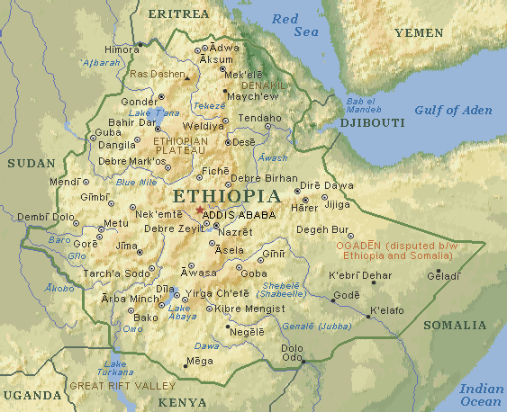

Slide 11
Ciano Foreign Minister
June 1936 report:
1) Two central interests
Relations with Arabs could enable Rome to put pressure on Britain and France
Such relations could increase Italian commercial and cultural influence
2) Avoid support to nationalist movements in French North Africa in order to cause same problems in Libya
3) Increase contacts with Ibn Saud, Imam Yahya, leaders of Arab Palestine, Mufti of Jerusalem, nationalist Syrian leaders
4) Increase propaganda
However, many Fascist hierarchs retained prejudices towards Arabs, speaking about oriental sour and susceptibility of peoples of those regions

Slide 12
Anti-semitism
Traditional ambiguity
Mussolini had always tailored statements on Jews according to needs of the moment
Second half of 1930s:
Large number of Jews among commentators criticising Ethiopian war
Good number of Jews in Giustizia e Libertà
Leon Blum and Popular Front in France
Arab Policy seemed not to have influenced attitude towards Jews

Slide 13
Preparation for war
Agreements with Yugoslavia 1937, stating beginning of friendly relationship and settling all border issues
Italy reduced troops on Eastern frontier and shipped army corps to Libya
Chiefs of Staff sought rapid victory with light troops in desert, rather than in the Alps
Attack to Sudan from Ethiopia still impossible. Better to concentrate efforts on Libyan front

Slide 14
Arms Sales
Ciano wanted to increase arms sales:
To increase Italian influence at Britain’s expense
To make weapons available for Arab rebels in Palestine
Ibn Saud wanted to keep good relations with Britain, without becoming too dependent on one nation
Italy wanted to see countries under mandate regime become independent
As regarded Palestine, Italy in 1937 had no official position yet, but mandate was important for relations with Arabs
Ibn Saud started purchasing weapons from Germany, which had no interests in Arabian Peninsula (no rivalry with Britain)

Slide 15
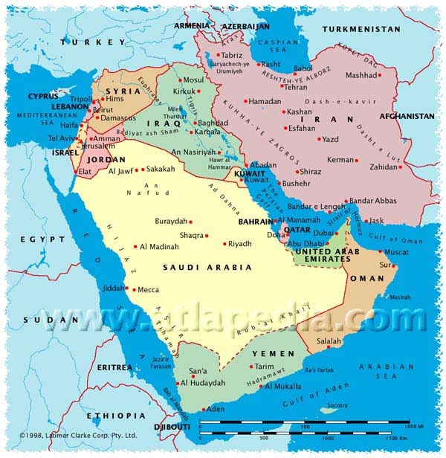

Slide 16
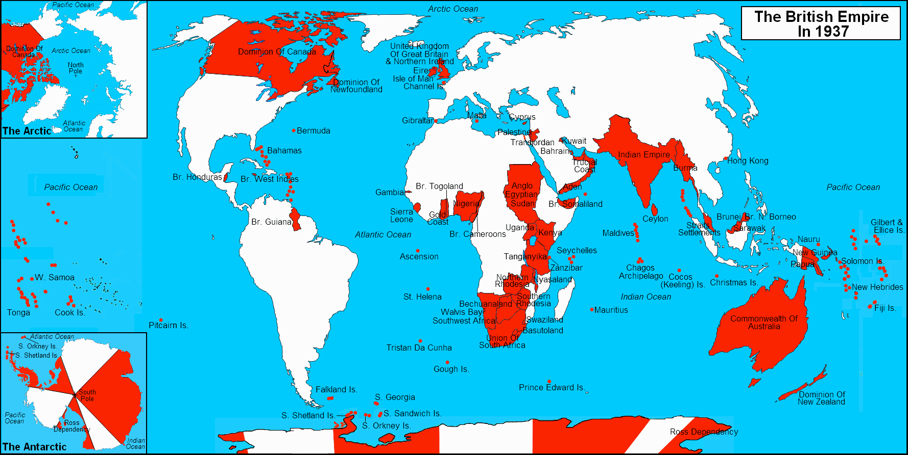

Slide 17
Aden and Yemen
British interests in Aden Protectorate safeguarded through series of treaties with local sheikhs
Ibn Saud extended sovereignty over tribes in South
Need to find agreement with Saudi Arabia on precise and stable borders
Imam Yahya chose to remain in Italian sphere of influence, beginning negotiations on purchasing of arms and ammunitions
This was a real threat to British maritime communications with India

Slide 18
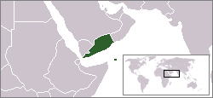

Slide 19
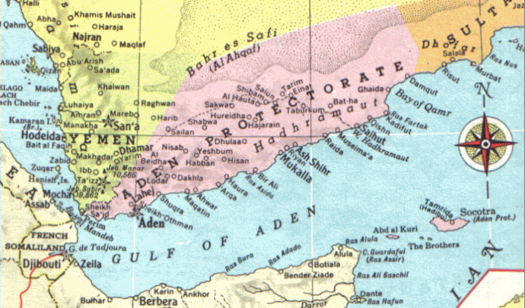

Slide 20
Fascist Muslim Policy in Ethiopia
Political and military use of Muslims in Ethiopia
Mosques built and restored
Muslims granted full religious freedom
Arabic became official language in Harar and taught in Muslim schools
In case of internal unrest, Muslim would constitute valuable reserve of men
Muslim troops used to crush revolt in Christian Amharic provinces in Oct-Nov 1937
Muslims good for public relations with Arab world
Money given for annual pilgrimage to Mecca
Good coverage in Arab press (no violent press campaign against brutal repressions against Christian population)
Dec 1937: Duke of Aosta replaced Graziani as Governor: all groups to be treated equally in order not to make France and Britain protectors of Christians in Africa

Slide 21
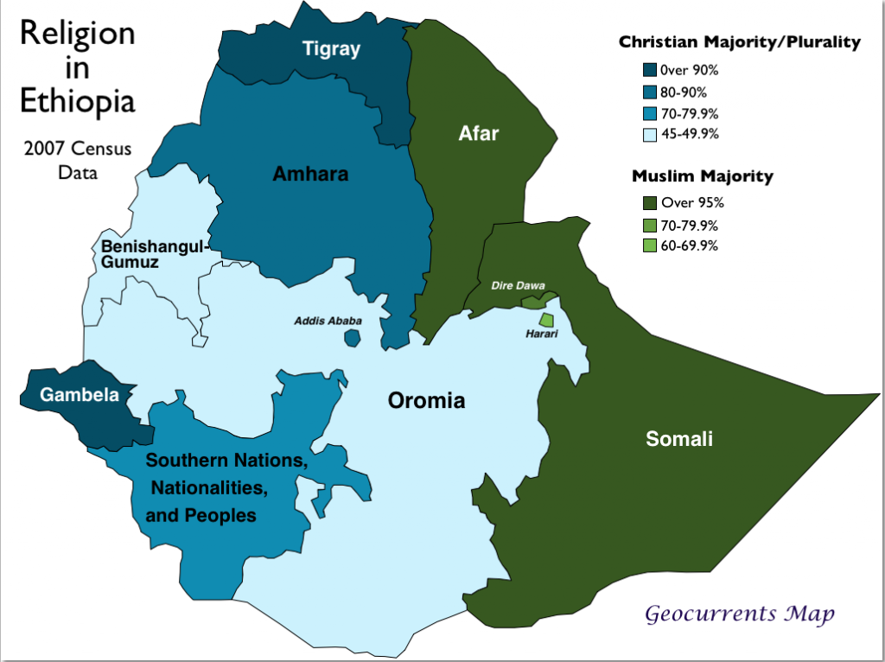

Slide 22
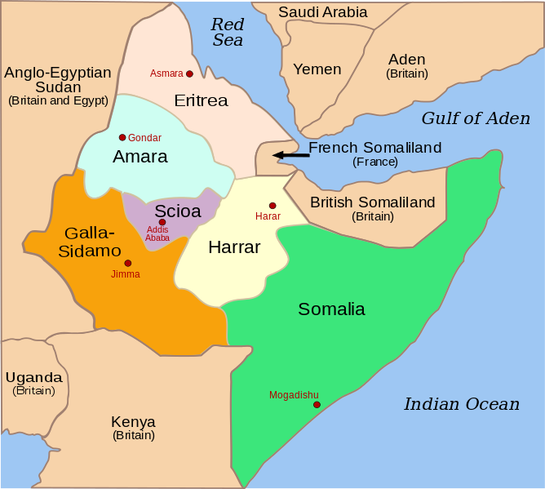
Italian East Africa

Slide 23
Muslim Policy in Libya
Mussolini’s visit Mar 1937
Sword of Islam
Mussolini addressed crowd: Italy intends to ensure Muslims in Libya and Ethiopia peace, justice, well-being, respect for the Prophet
Italian media proclaimed Mussolini as Protector of Islam

Slide 24
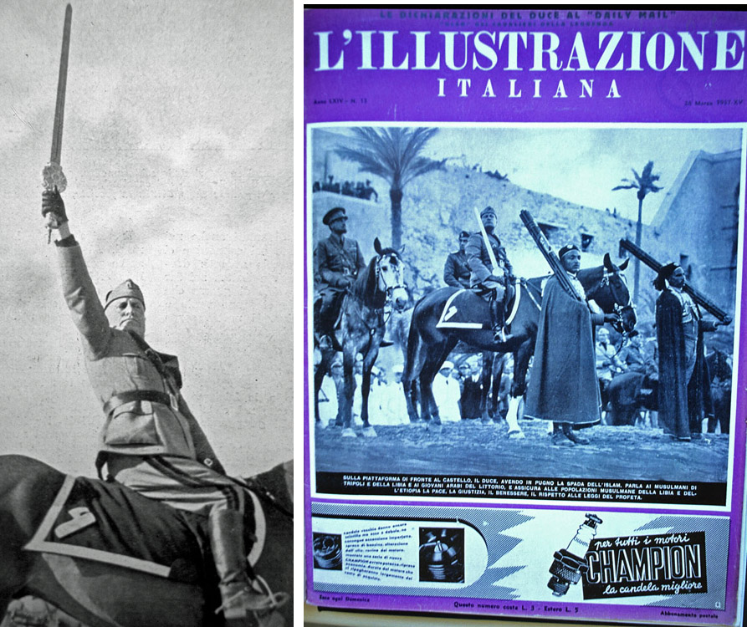

Slide 25
Propaganda war with Britain
Italian press portrayed difference between Libya, where Italy had brought progress, and India, which had been reduced in poverty
Foreign Office made BBC trasmit in languages other than English, included Arabic
Italy used Muslim discontent of Britain as a lever to pursue her interests in Arabian Peninsula and Palestine
Jews of Palestine deterred from collaborating with Italy by links with Nazi Germany
In Syria, Lebanon and Iraq Italy backed only by peripheral elements of society
While some Arabs saw Italy as an aid to gain independence, others did not believe that an imperialist power would be better than any other one

