Slide 1
Prof. Bruno Pierri History of Italian Foreign Policy
Italian Emigration: A Historiographical Analysis, 1860-1960
February 17th, 2016

Slide 2
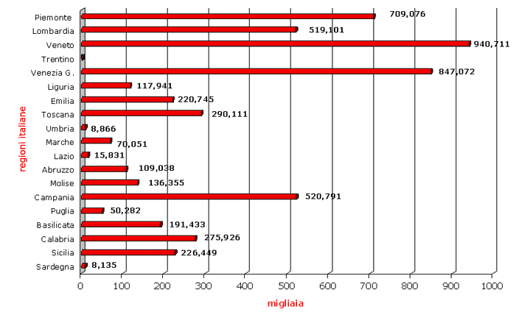
1876-1900

Slide 3
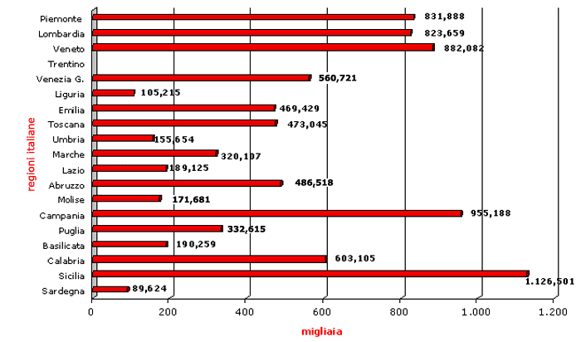
1901-1915

Slide 4
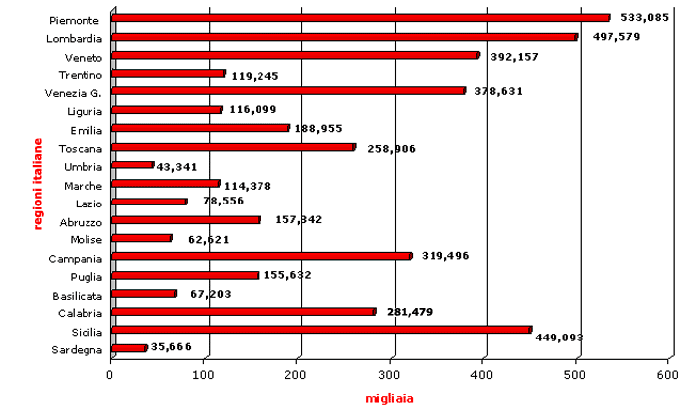
1916-1942

Slide 5
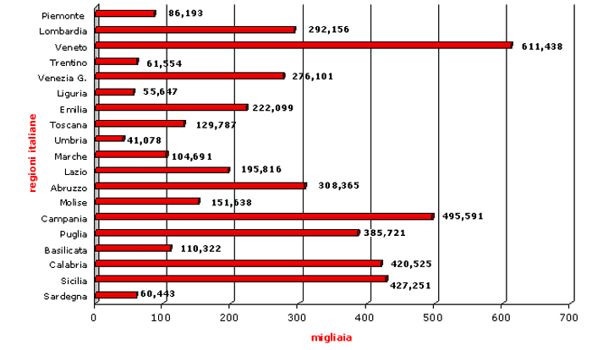
1946-1961

Slide 6
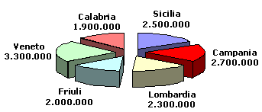
1876-1976

Slide 7
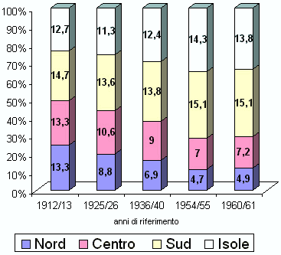

Slide 8
A few numbers
By outbreak of WW2, some 20 million Italians had been involved in emigration process since 1860, of whom 14 million remained permanently domiciled outside Italy
Flux restarted after 1945
Further 7million left in following 20 years
1950s:10 million moved within Italy, or Europe, or overseas
1970s: birthrate declined, emigration practlically halted and Italy turned into a country of immigration: some were “Italians” coming back, others were from other ethnicities

Slide 9
Emigration for Liberal Italy
Most obvious failure of State
Emigration showed that pretension to feed and defend population was limited
For Liberals, emigration was a problem
Laissez-faire ideology: Govt not to intrude too far into lives of people – Britain had never blocked emigration and this commitment to liberty was secret of success
Success did not come in Italy: growing numbers of emigrants – 100,000 left in 1876, 293,000 in 1895, 872,000 in 1913
Distant destinations: Americas
Before WW1, emigration focus shifted from North to South
Sardinia: emigration counted little due to pastoral economy
Emigration counted less wherever industrialisation, full-scale agriculture, modernisation and socialism were strong
Emigration counted less for great estates labourers and much more for peasants into whose lives market economy was intruding and where land sales were occurring

Slide 10
Issues for Politicians
Should many forms of exploitation on emigrants (before, during and after arrival) be curbed or policed by Italian Govt?
How could Italy best benefit from emigrants? Money from emigrants to families in Italy helped balancing national budget
What did emigration mean for Italian reputation and power? – were emigrants lost souls and bodies whose blood to be absorbed to benefit of others, or were they like drops of rain in the sand?
Were emigrants conscious of their nationality, or did they need to to be instructed in italianità?

Slide 11
Legislation
Since 1873 Prefects obliged to keep accurate statistics of departures
Crispi: only empire could solve emigration problem
Giolitti: emigration as safety valve
Italophobia in host societies

Slide 12
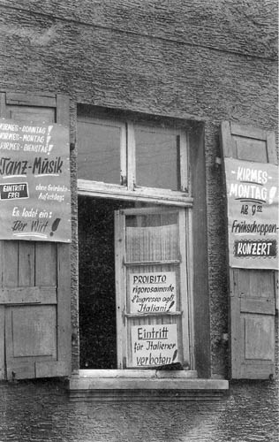
Notes:
Vietato l'ingresso agli italiani Una fotografia scattata nel 1958 a Saarbrucken, alla finestra di un club. Il divieto d'ingresso per gli italiani era bilingue. Si tratta solo di un esempio: simili avvisi, in Germania e soprattutto in Svizzera, erano frequentissimi.

Slide 13
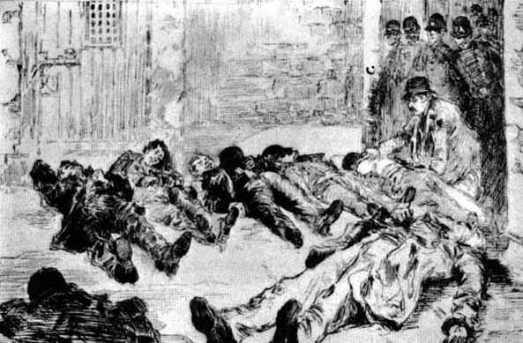
Notes:
New Orleans, eccidio in carcere Una immagine del linciaggio di 11 italiani a New Orleans tratta dalla rivista Illustrated American del 4 aprile 1891 e ripubblicata da Richard Gambino nel libro "Vendetta" edito da Sperling & Kupfer nel 1975. Racconta Gambino che le mamme con i bambini in braccio si chinavano sui cadaveri per inzuppare i fazzoletti nel sangue come souvenir.

Slide 14
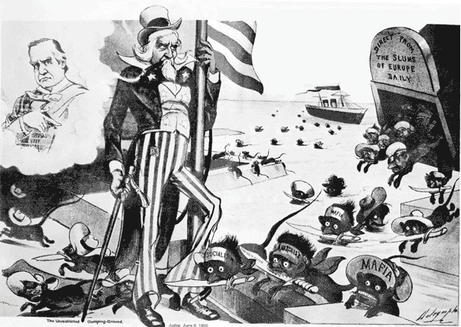

Slide 15
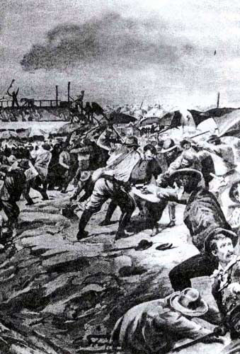
Notes:
Aigues Mortes, linciati alle saline Nel disegno di G.Starace sull'"Illustrazione italiana" del 1893, "Le prime aggressioni alle saline della fangouse", dove ebbero inizio i disordini sfociati nel massacro di Aigues Mortes. Gli operai francesi accusavano gli italiani di rubare il lavoro. Pochi anni prima, nell'inchiesta parlamentare sulla condizione operaia nota come Rapporto Spuller, un sindacalista parigino aveva fatto mettere a verbale: "L'operaio italiano è caratterizzato dal fatto d'essere più docile, più malleabile; gli si fa fare tutto ciò che si vuole, abbassa la schiena e tende la guancia per ricevere un altro schiaffo. Come uomo, trovo la cosa rivoltante. Questi operai non hanno dignità personale; sopportano tutto, chinano il capo e obbediscono".

Slide 16
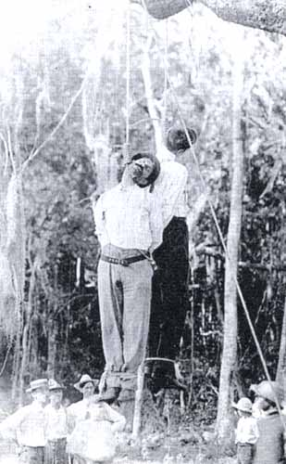
Notes:
Impiccati dopo lo sciopero Nella foto, scattata nel 1910 a Tampa, in Florida, esposta qualche anno fa nella mostra Without Sanctuary: Lynching Photography in America, e pubblicata dalla rivista "Passato e presente" n. 55 nel gennaio 2002, due italiani linciati durante uno sciopero nelle fabbriche di tabacchi. Quello piccolino si chiamava Costanzo Ficarotta, quello alto Angelo Albano. Sui motivi del linciaggio gli studiosi sono divisi. Secondo Patrizia Salvetti i due erano accusati di avere fatto un attentato al dirigente di uno stabilimento, secondo Alessandra Lorini furono "puniti" così barbaramente solo perché erano dei crumiri.

Slide 17
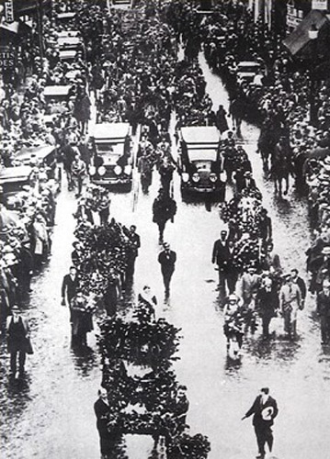
Notes:
I funerali di Nic&Burt: la svolta Nella foto, i funerali di Nicola Sacco e Bartolomeo Vanzetti, seguiti da una folla immensa. L'onda emotiva seguita all'esecuzione dei due anarchici italiani, della cui innocenza moltissimi americani si erano ormai convinti, contribuì a cambiare molto l'atteggiamento dell'opinione pubblica degli Stati Uniti dei confronti della nostra comunità. Non a caso fu dopo la morte di quelli che erano stati adottati come "Nic &Burt", che i nostri emigrati cominciarono ad assumere alcune posizioni di rilievo. Angelo Rossi fu eletto ad esempio sindaco a San Francisco e Fiorello La Guardia acclamato sindaco di New York.

Slide 18
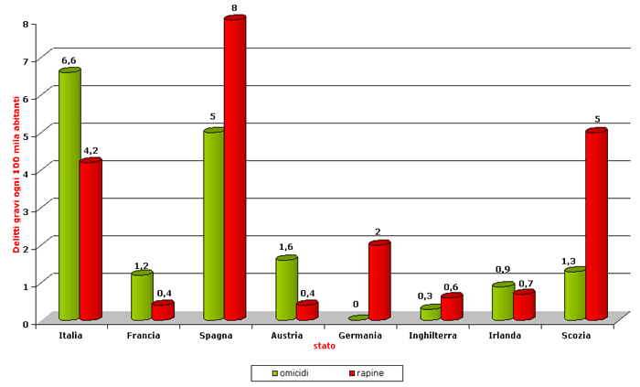
Criminalità in Europa 1861-1955

Slide 19
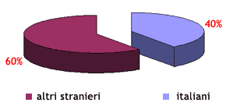
Carcerati USA 1920

Slide 20
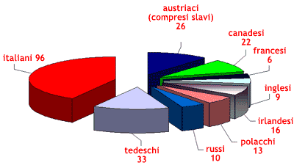
USA 1904 Italiani arrestati per omicidio

Slide 21
Catholics
Some Bishops bewailed fate of poor emigrants exposed to Protestantism or godless materialism
Catholic welfare among emigrant communities
Collaboration with local consuls and lay intellectuals

Slide 22
Socialists
By 1900 socialist chiefs still advised Italian workers abroad to join local unions and forget nationalist particularism
Togliatti and Gramsci silent about emigration, but general message was “do not emigrate”, in order for workers and peasants to stay unite and fight against bosses
Left wing has traditionally had limited appeal among Italians abroad

Slide 23
Fascism
1927: word emigrant abolished
Regime committed to win battle of births and encouraged rapid increase of population
1928: legal restrictions on permament emigration
a) prohibition of stable emigration; b) tolerance only for temporary emigration, as profitable for economy
c) qualified emigration of professionals, technicians, and students
d) emigration towards Italian colonies
e) return of emigrants from abroad

Slide 24
United States Legislation
Literacy Act
1917: non admission of illiterates
1921 Quota Act: immigration of only 3% of fellow nationals resident in America in 1910, reduced to 2% of 1890 component in 1924
Italian emigration obliged to deviate towards France, Argentina, Brazil, Australia…
Mussolini 1922: "Se ci si desse la possibilità di mandare in America un centomila dei nostri sobri ed operosi emigranti, io credo che ne trarrebbe vantaggio tanto gli Stati Uniti quanto l'Italia" - no answer from American Administration
Mussolini, May 24, 1924: "Noi non vogliamo mandare negli Stati Uniti la nostra gente ammalata, pazza o pericolosa. Noi pensiamo agli italiani sani quando discutiamo di immigrazione col vostro paese"
Mussolini Nov 15, 1924: "Siamo oggi stati colpiti rudemente dall'Immigration Bill. Non basta dire da parte dei popoli che sono arrivati: "stiamo tranquilli", perché se noi non sappiamo dove mandare il nostro dippiù di umanità, se non sappiamo dove trovare le materie prime che ci devono far vivere all'interno, questa è una pace di aguzzini"

Slide 25
Fuoriusciti
They launched political movements – Giustizia and Libertà
They negotiated among themselves to found anti-Fascist popular Front
Except from communists, they lacked genuine popular base
WW2 gave them chance to end irrelevance and leave their exile – F. Parri 1945
Despite this, emigrants abroad had been little affected by anti-Fascist intellectuals
Emigration began again soon after war
Alcide De Gasperi – best solution for poor Italians is to learn a language and go abroad
M. Rumor – emigration as a process able to safeguard domestic balance against pressure of masses
Emigration as necessary tonic for social problems
Nationalists and neo-Fascists: change of regime did not alter national interests; unfair to lose colonies

Slide 26
Destinations
Massive presence in Argentina
81% of workforce
One third of urban population of Buenos Aires
Massive contribution to music, literature, arts, science, politics, military…
In S. America, Italians were appreciated as workers, but were aristocracy of labour
1914: argentinisation of immigrants to be accelerated
Italianità remained a nebulous matter, except where subsidy encouraged its disclosure
Latin, but not so Italian

Slide 27
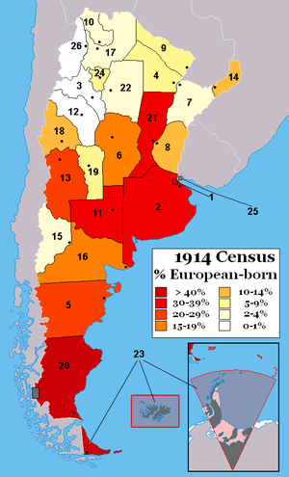

Slide 28
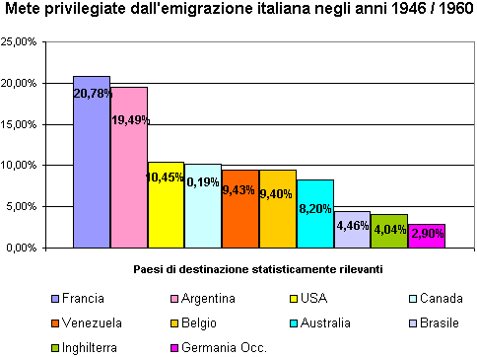

Slide 29
Destinations
Britain
By the 1870s the main regional origins of Italian emigration to Britain were the valleys of Parma in the north, and the Liri valley, half way between Rome and Naples.
The people from Parma were predominantely organ grinders, while the Neapolitans from the Liri valley (now under Lazio) made ice cream......
After this date all itinerant employment crossed regional demarcations....
But the announcement to side with Germany in 1940 had a devastating effect. By order of parliament all aliens were to be interned. Some had married British women and even taken British citizenship.
The Italians were now seen as a national security threat. All Italian men between the ages of 17 and 60 were arrested. They were transported to camps across the country.
In the 1950s Italian immigration started again. It was made mainly of southern Italians. But in the 1960s it tapered off and practically stopped in the 1970s.
Now London hosts around 400,000 Italians

Slide 30
Destinations
USA
The early arrivals were scattered throughout the country, with the largest concentration in the northeast. It was there that recognition of their common Italian roots and culture was the greatest.
The first Columbus Day celebration was organized by Italian Americans in San Francisco in 1869. Italian American involvement in politics was already underway

Slide 31
Destination USA (1880-1914)
Italian unification in 1861 caused economic conditions to considerably worsen for many in southern Italy. A number of major contributing factors were responsible for the large exodus from southern Italy and Sicily after unification, including: political and social unrest; the government’s allocation of many of its resources to the industrialization of the North; inequitable tax burden on the South; tariffs on the products of the South; soil exhaustion and erosion; and military conscription lasting seven years.
From 1880 to 1920, an estimated 4 million Italian immigrants arrived in the United States. Once in America, the immigrants faced great challenges. Often with no knowledge of the English language and with little formal education, many of the immigrants were compelled to accept low-wage manual-labor jobs
About a third of the immigrants, so-called "birds of passage", intended to stay in the United States for only a limited time, followed by a return to Italy with enough in savings to re-establish themselves
In time, the Italian immigrants and their descendants adjusted to life in their adopted country, and began making contributions to mainstream American life and culture.

Slide 32
Destination USA: World War I and the Interwar period
By 1920, the Little Italies had stabilized and grown considerably more prosperous as workers were able to obtain higher-paying jobs. English was now the language most commonly heard on the streets of the Little Italies
The Italian American community wholeheartedly supported the war effort
In the post-war years, jobs as policemen, firemen and civil servants became available to Italian Americans; while others found employment as plumbers, electricians, mechanics and carpenters. Women found jobs as civil servants, secretaries, dressmakers, and clerks
Italian Americans of the post-war years contributed significantly to American life and culture.
In business, Italian Americans were the nation's chief supplier of fresh fruits and vegetables
Also in California, Italian Americans were leading growers of grapes, and producers of wine

Slide 33
Destination USA: World War II and the post-war decades
At least half a million Italian Americans served in the various branches of the military in World War II
In spite of this display of loyalty, hundreds of Italians viewed as a potential threat to the country were interned in detention camps
The post-war period was a time of great social change for Italian Americans. Many aspired to a college education. With better job opportunities, and better educated, Italian Americans entered mainstream American life in great numbers. The Italian enclaves were largely abandoned by the younger generation. Many married outside of their ethnic group, most frequently with other ethnic Catholics, but increasingly also with those of diverse religious and ethnic backgrounds
Italians continued to immigrate after the war, and an estimated 600,000 arrived in the United States in the post-war decades. Many were well educated

Slide 34
Immigration and Nationality Act of 1952
The Act defined three types of immigrants:
immigrants with special skills or relatives of U.S. citizens who were exempt from quotas and who were to be admitted without restrictions
average immigrants whose numbers were not supposed to exceed 270,000 per year
refugees.
The Act allowed the government to deport immigrants or naturalized citizens engaged in subversive activities and also allowed the barring of suspected subversives from entering the country.

Slide 35
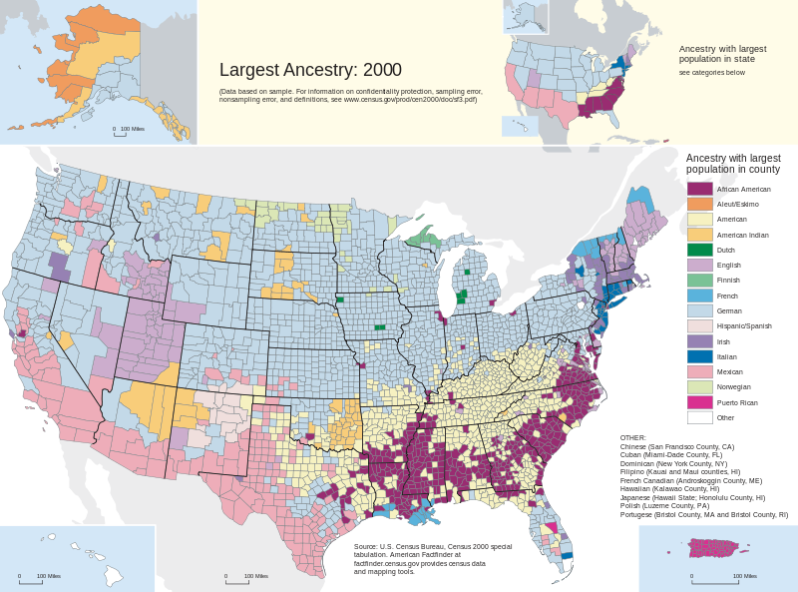

Slide 36
Destination Australia
Italian Australians are the fourth largest ethnic group
By Italian Government estimates, fully two-fifths of its emigrants to Australia were from Veneto and another two-fifths were drawn from Piedmont, Lombardy, and Tuscany
Only one-fifth were from Sicily and Calabria

Slide 37
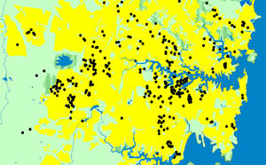
Sidney
Notes:
one dot denotes 100 Italy born Sydney residents

Slide 38
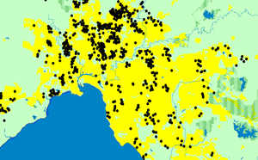
Melbourne

Slide 39
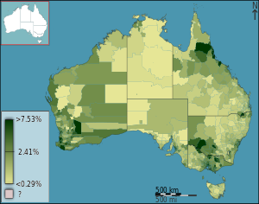
Notes:
People with Italian ancestry as a percentage of the population in Australia divided geographically by statistical local area, as of the 2011 census

