Slide 1
Prof. B. Pierri History of Italian Foreign Policy
The Abyssinian War and the Middle Eastern aftermath
March 15th, 2016

Slide 2
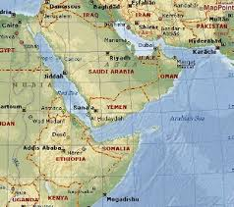

Slide 4
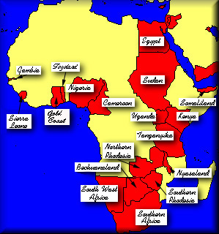

Slide 5
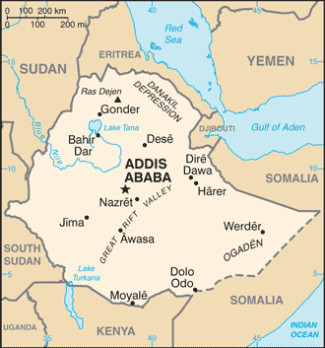

Slide 6
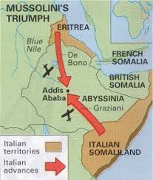

Slide 7
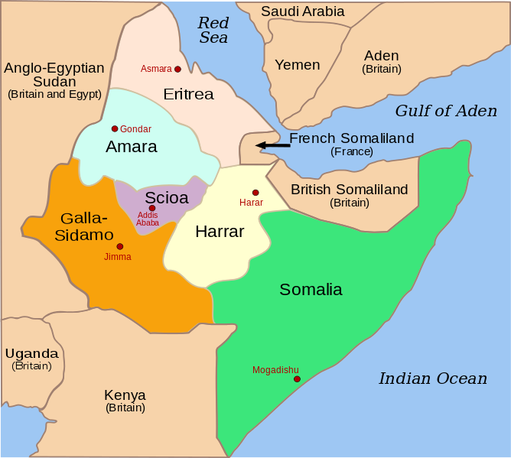
Italian East Africa

Slide 8
Mussolini-Laval Agreements Jan 1935
Jan 1935: treaty that defined disputed parts of French Somaliland as part of Eritrea, redefined the official status of Italians in French-held Tunisia, and essentially gave the Italians a free hand in dealing with Ethiopia
Italy was also to receive the Aozuzu Strip, which was to be moved from French-ruled Chad to Libya
In exchange for all these concessions, France hoped for Italian support against German aggression

Slide 9
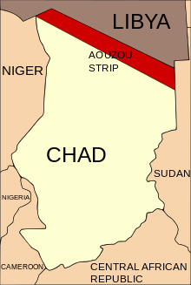

Slide 10
Anti-British line: summer 1935
Native Policy: Britain to protect native peoples
London had to control Lake Tsana waters and keep stability among Ethiopian populations and those leaving in border and grazing areas
Another colonial war as a threat to stability of area
French had only economic interests in Horn (Djibuti-Addis Abeba railway)
Italy had to reach agreement with London on grazing and watering rights of Somalis in Ethiopia

Slide 11
Anglo-Italian rivarly
Mussolini wanted Britain to give him free hand in conquest of Ethiopia
London wanted Italy to reach compromise with Ethiopia through diplomacy
Maffey Report
Question examined only from British point of view
London had interests in Ogaden and Harar on grazing and watering rights, while in North-West Lake Tsana waters were pivotal for Sudan and Egypt
In case of Italian conquest of all Ethiopia, Sudan would have had more than 3,000 km of border with European power claming economic expansion.
In case of war against Italy, colonial blockade in Horn would have been a serious threat to British strategic positions in Red Sea and Gulf of Aden
It was always possibile for Fascist regime to seek more glory in the North
Independent Ethiopia was better for Britain. However, since the risk of war against Italy was very unlikely, and since a frontier with European power was always safer than one with unstable country, for Britain it did not make any difference if Ethiopia was independent or not

Slide 13
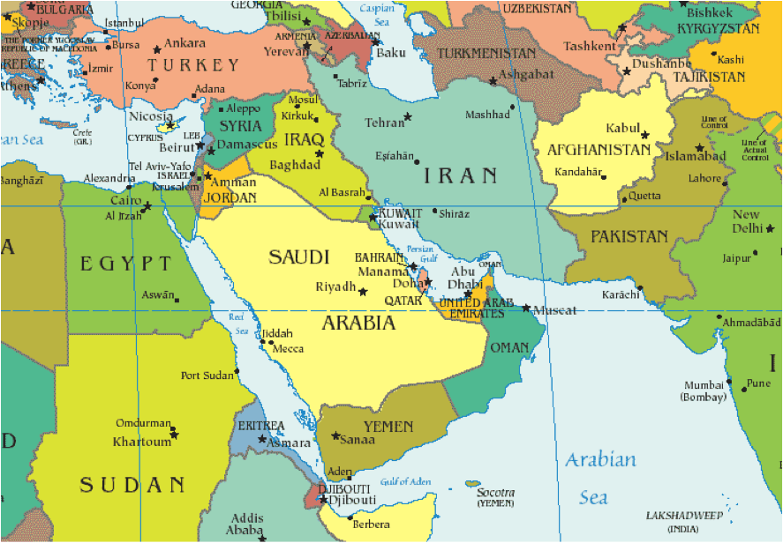
British Interests in Suez and Red Sea

Slide 14
British Interests in Suez and Red Sea
Suez Canal as a swinging door of Empire
Shortcut to reach colonies in Indian Subcontinent and Australia
Divergence with France, which put pressure on Addis Abeba to give as many concessions to Italy as possibile

Slide 15
Italian Propaganda in Middle East
Abyssinia and slavery
Abyssians as enemies of Egypt and Islam
Objective was rallying Arabs and Muslims
Blue Shirts Movement in Egypt got information on history of fascism
Luce newreels on agricultural developments in Libya
Radio Bari denounced British imperialism which subjugated about ¾ of Muslim world
Propaganda on Christian-Muslim rivalry in Ethiopia
Report on Muslims in Ethiopia
1) Moslems lacked leadership, had low education and low level of religious awareness
2) Moslems excluded from public offices due to Christian fanaticism and low education

Slide 16
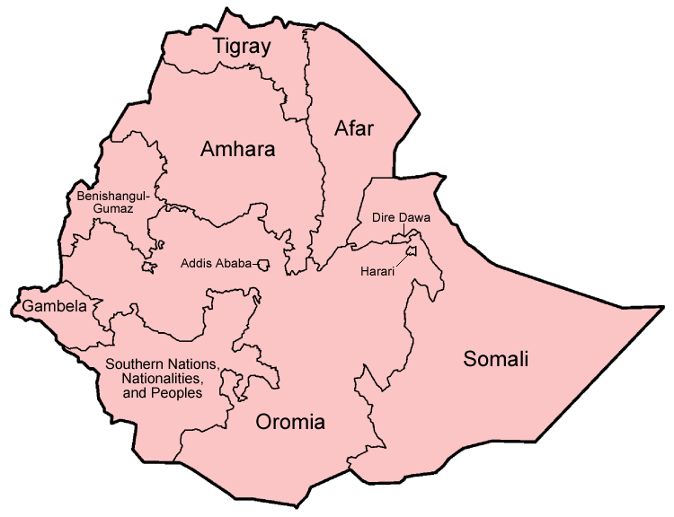

Slide 17
Hoare-Laval Pact
Anglo-French proposal approved Dec 8
Recommendation to Emperor to accept some territorial changes in favour of Italy
Easter Tigray, Dankalia, Ogaden
French monopoly on railways
Italian Economic sphere of influence in South (with military presence?)
Oil embargo against Italy to discuss in League of Nations. Laval sure that Mussolini could wage war on this, thus he suggested further attempts of reconciliation
In case of war, Laval did not want to accept precise duties towards Britain

Slide 18
King Edward VIII
Secret meeting with Italian ambassador
King contrary to British Govt policies, while admiring Italian colonial enterprise
War Britain-Italy could provoke deflagration of Europe
The conquest of Abyssinia cured the continent from “[…] a secular centre of infection […] and make it possible an effective cooperation in that big part of Africa between the colonising mission of Italy and Britain”.
He committed himself personally to avoid any war against Italy, with whom cooperation in Mediterranean was pivotal
[1] Cfr. L’ambasciatore a Londra, Grandi, al Capo del Governo e Ministro degli Esteri, Mussolini, 29 aprile 1936, L.P., in DDI, Ottava Serie, Vol. III, pp. 843-856.
[2] Cfr. L’ambasciatore a Londra, Grandi, al Capo del Governo e Ministro degli Esteri, Mussolini, 1° maggio 1936, L.P., in DDI, Ottava Serie, Vol. III, pp. 867-870.

Slide 19
Britain and Egypt
Ethiopian crisis as catalyst for Egyptian independence
Lampson (British commissioner) said that only positive outcome of Italian invasion of Abyssinia was that population in Egypt would accept some form of British control
Mussolini denied that Italy posed a threat to Egypt
Unilateral formal independence to Egypt Feb 28 1922
Aug 1936 Treaty of Alliance Britain-Egypt
Britain allowed to build military bases in Suez Canal area and station 10,000 soldiers and 400 Royal Air Force men
Egypt had to build infrastructures for communications
In case of war, Egypt to put at British disposal all necessary infrastructures for Canal and country defence

Slide 20
Italians in Egypt
Mussolini wanted to show that all Italians, both at home and abroad, supported conquest of Ethiopia
Disciplined but enthusiastic manifestations while Italian ships went through Suez Canal
Contacts between Italian Legation and Young Egypt leaders
Italy to back full Egyptian independence in case of Egyptian support to Italian interests in Ethiopia

Slide 21
Saudi Reactions
Officially neutral
No sanctions implemented against Italy: not a member of League of Nations
As warden of holy places, Saudi Arabia obliged to keep friendly relations with all countries with Muslim subjects
Status of Italy as Red Sea power was cause of concern for Ibn Saud
Britain could not grant military support in case of Italian attack against S. Arabia (Rome Agreement 1927)
Ibn Saud suspicious of Italy: treaty of alliance with Iraq: mutual defence in case of attack by third party

Slide 22
Yemen
Imam Yahya (ruler of Yemen) approached by Ethiopians in Spring 1935 to sign treaty of friendship
Treaty with Ethiopia was to have no effects on good relations with Italy, since it only dealt with trade
Mussolini: any occupation of Yemenite territory would provoke a conflict with UK. Better to improve relations with Yemen
Yemen neutral during war, banning arms both to Italy and Ethiopia
Limited assistance to Italian war effort: civilians labourers sent to Eritrea
Britain could not grant military support in case of Italian attack against Yemen (Rome Agreement 1927)

Slide 23
Palestine
Italy tried to persuade Zionist leaders to influence British not to include Palestine in sanctions
Jewish opposition to war might have induced Mussolini to revise attitude towards Jews
No pressure on Palestinian Arabs, probably not able to influence Britain
However, Radio Bari broadcast propaganda to arouse indignation towards Britain, as sanctions harmed Palestine’s economy
Ciano appointed Minister of Foreign Affairs June 1936: connections with Zionism gradually severed. Relations with Palestinian Arab leaders began to flourish
Mufti of Jerusalem appealed to Italian Consul General in Jerusalem to supply arms and money with which he could start revolt against British

Slide 24
Zionist reactions
Mainstream Zionism generally critical towards Italy
Weizmann had no hopes of obtaining anything from Italy and openly sided with British
Revisionist Zionists more sympathetic towards Italy: press articles stating that Negus was a tyrant and that victory of Italy was better for white race. Moreover, Jews of Palestine would benefit from Italian threat to British in Suez Canal area - mandatory power could be induced to give Jews a state

Slide 25
Syria, Lebanon, Iraq
Syrian and Lebanese public opinion more open towards Italy
Italian threat quite far away
Benefits from good Italo-French relations
Opposition to war led by Orthodox clergy, anti-colonialist circles and ultra-religious Muslims
Iraq took a strong stand against Italy and sanctions were implemented
AGIP in 1935 had 52% of shares in Mosul Oil Fields, multinational company with substantial concessions in Northern Iraq
In 1936 Italian govt no longer able to maintain financial support of AGIP committments in Iraq – all shares sold (expansion in Africa more important than independent access to Iraqi oil)

Slide 26
Red Line Agreement
Signed by partners in the Turkish Petroleum Company (TPC) on July 31, 1928
The aim of the agreement was to bind all partners to a "self-denial clause" that prohibited any of its shareholders from independently seeking oil interests in the ex-Ottoman territory

Slide 27
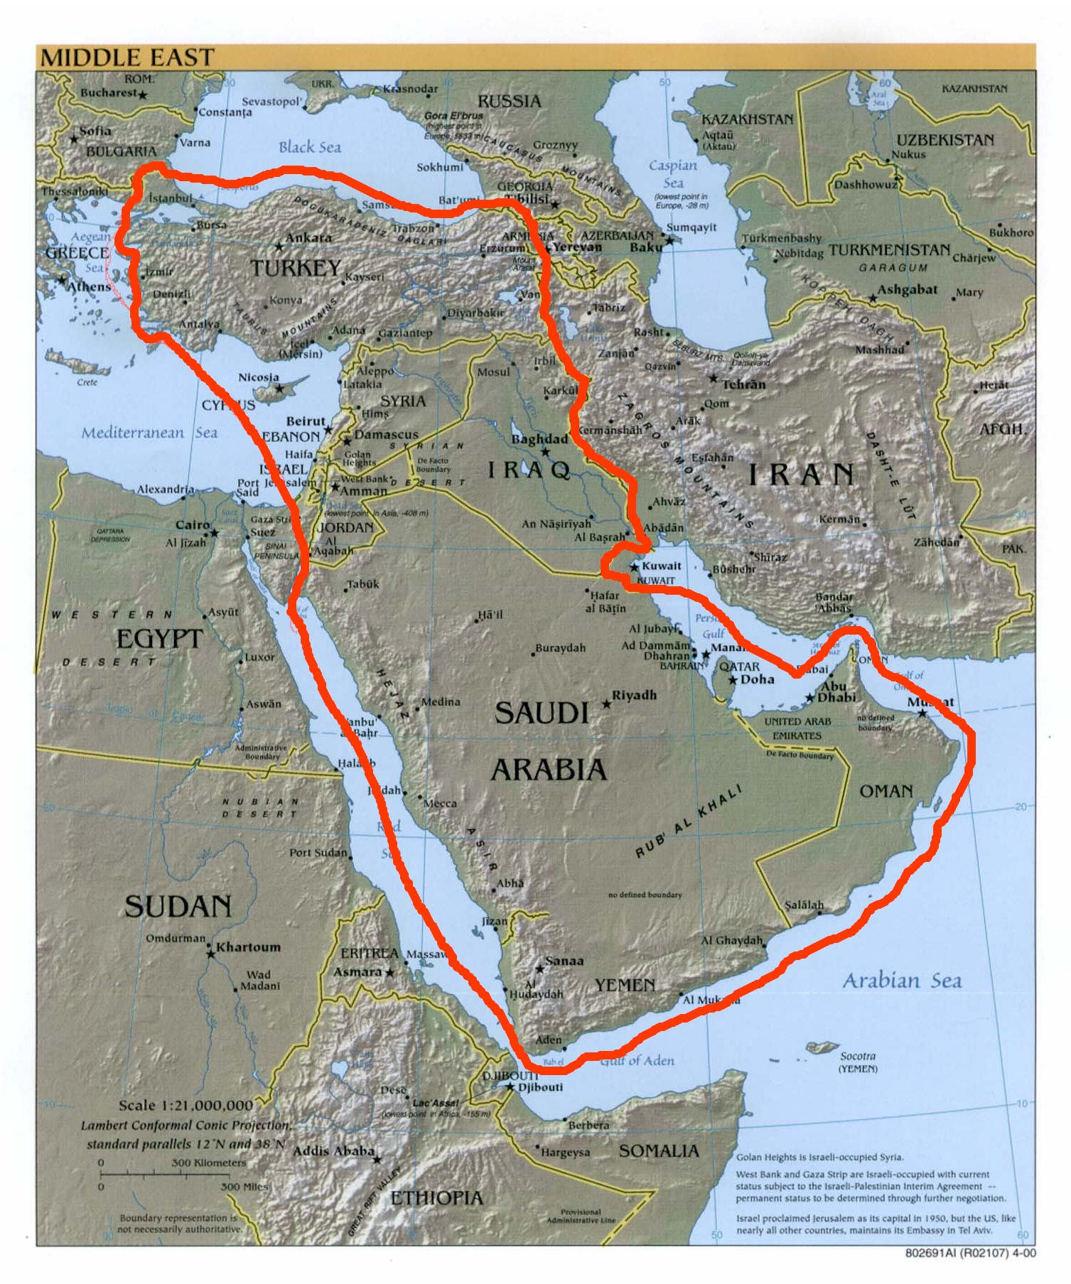

Slide 28
