Slide 1
Prof. Bruno Pierri History of Italian Foreign Policy
Fascist Italy and the Middle East: From the Treaty of London to the first Fascist Decade March 9th, 2016

Slide 2
Treaty of London
Middle East played good part in Italian decision to join war
French and British bombed Dardanelles: Italy believed it could become too late to take part in partition of Turkey
Telegram to Italian Ambassador to London: «Italian Govt, for reasons of loyalty to Austria and Germany, wish to keep scrict neutrality, but in light of threats which may derive from a changed territorial asset in the Balkans, Adriatic, and in general European and Mediterranean area, as well as the threat coming from German and Austrian resentment due to Italian neutrality, think it possible to join British, French and Russian war effort. However, for economic reasons this option must be necessarily followed by a series of guarantees...»
26.04.1915 Italy to join war within a month with Entente, in exchange of, in case of victory, Trentino, Southern Tirol, Venezia Giulia, Istria except Fiume, part of Dalmatia, several isles in Adriatic, Vlona and Saseno in Albania, coal fields in Turkey. Territorial compensations in Africa to detriment of German colonies. Italian committemnt to fight with Britain, France and Russia aganinst all of their enemies

Slide 3
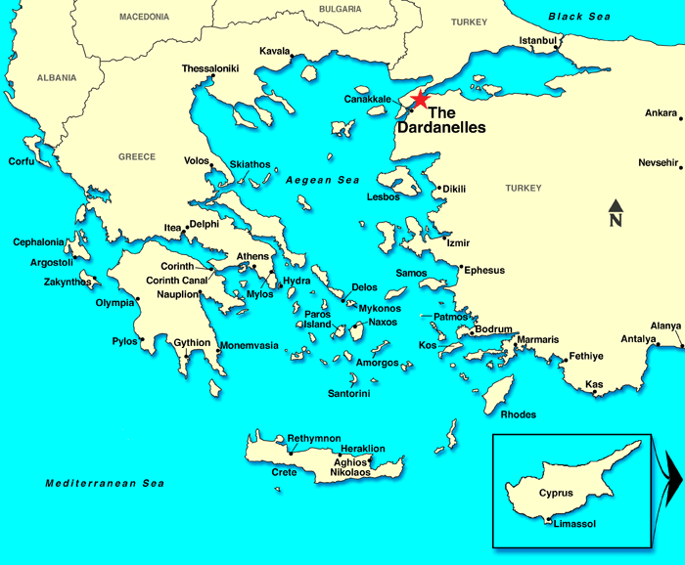

Slide 4
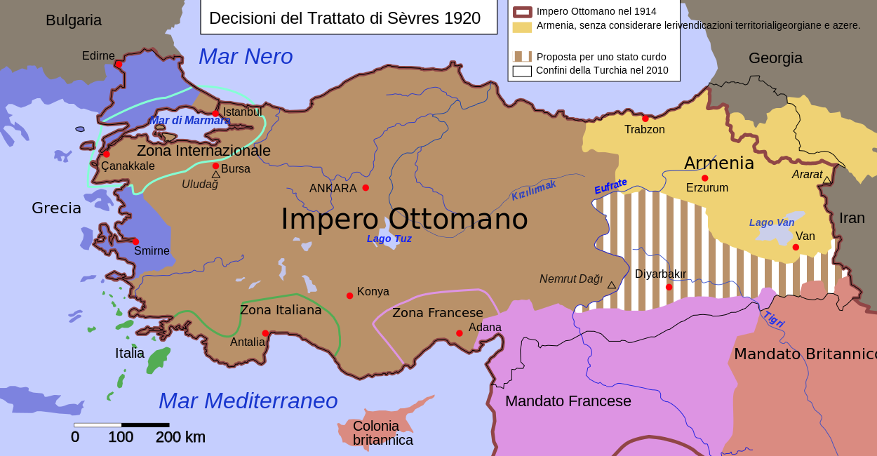

Slide 5
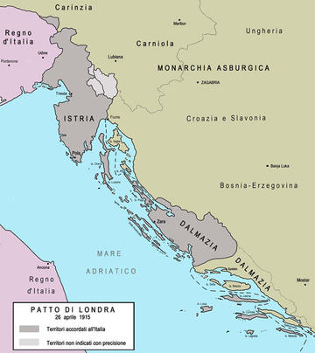

Slide 6
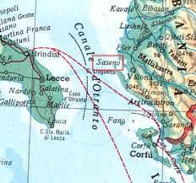

Slide 7
Treaty of London – Middle East and Africa
ARTICLE 8. Italy shall receive entire sovereignty over the Dodecanese Islands which she is at present is occupying
ARTICLE 9. France, Great Britain, and Russia recognise that,... in the event of total or partial partition of Turkey in Asia, she [Italy] ought to obtain a just share of the Mediterranean region adjacent to the province of Adalia....
ARTICLE 13. In the event of France and Great Britain increasing their colonial territories in Africa at the expense of Germany, those two Powers agree in principle that Italy may claim some equitable compensation....

Slide 8
Sykes–Picot Agreement
16 May 1916: Secret agreement between Britain and France, with the assent of Russia, defining spheres of influence and control in Middle East in case of defeat of Ottoman Empire
The agreement effectively divided Arab provinces of the Ottoman Empire outside the Arabian peninsula into areas of future British and French control or influence
Foreign Minister Sonnino claimed Italian participation and information of any agreements dealing with holy places in Arabia, since many Italian subjects were Muslim. Italy claimed to be a Muslim power

Slide 9
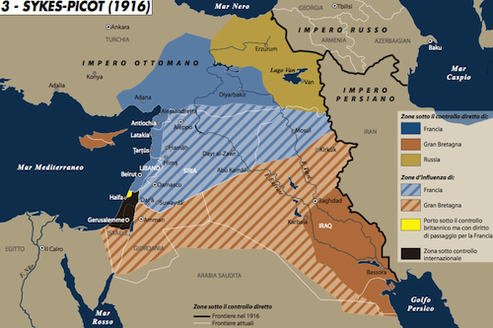

Slide 10
Francesco Saverio Nitti
After the war, Nitti believed colonial adventures would involve Italy in economic ruin and catastrophic military consequences
Following Kemal’s rise, Itay decided to withdraw troops and establish friendly relations with Turkey

Slide 11
Young Mussolini
Cultural heritage: Impressed by orientalism
Sense of superiority and generalization about Arabs: avoid sexual relations among races
Support of Middle Eastern countries’ independence from France and Britain: expansion not only in terms of territorial conquests
Middle East as a great opportunity for Italy. Large countries with scarce population

Slide 12
Pre-March on Rome rethoric
Classic imperialist tones: Mediterranean as a natural field for Italy and doorway to Africa
Italy needed space for existence and had civilizing mission

Slide 13
First agreements with Britain
Jarabus oasis and Jubaland ceded to Italy
Continuity of Cavourian policy: step by step territorial gains

Slide 14
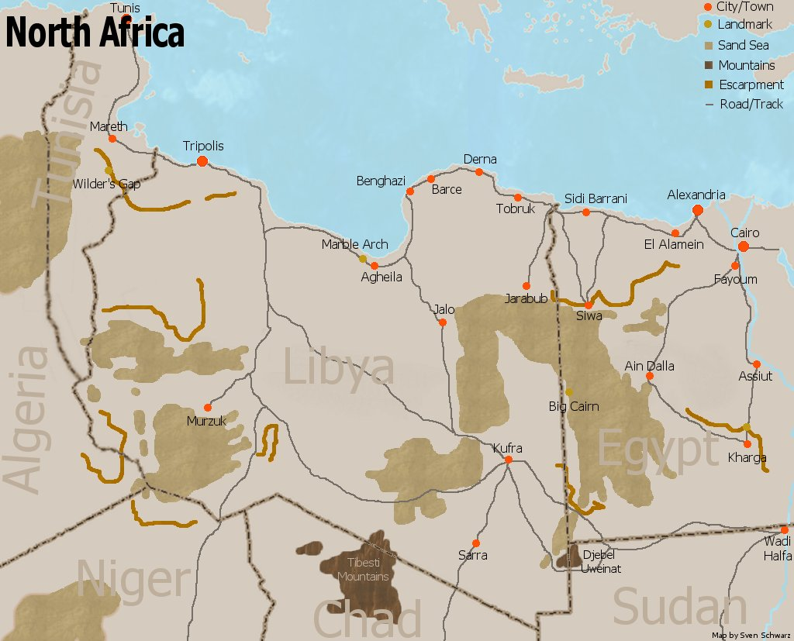

Slide 15
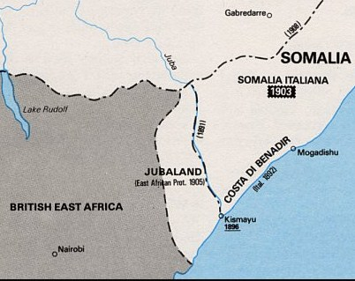

Slide 16
Mandates
After realising that Mandates could not be redistributed, Mussolini turned to old policy of advocating weak independent states subject to Italian influence
By putting pressure from Red Sea shores, Italy hoped to extend sphere of influence and establish special relations on Arabian Peninsula, starting from Yemen
1923-1926: Italian economic and cultural penetration in Yemen: building of infrastructures and trade of oil: first country to recognise Yemeni independence in 1926
In the same years, Abd al-Aziz al-Saud, ruler of Hijaz, united the rest of the peninsula under his new kingdom of Saudi Arabia, British ally

Slide 17
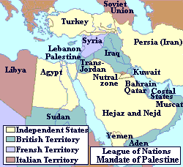

Slide 18
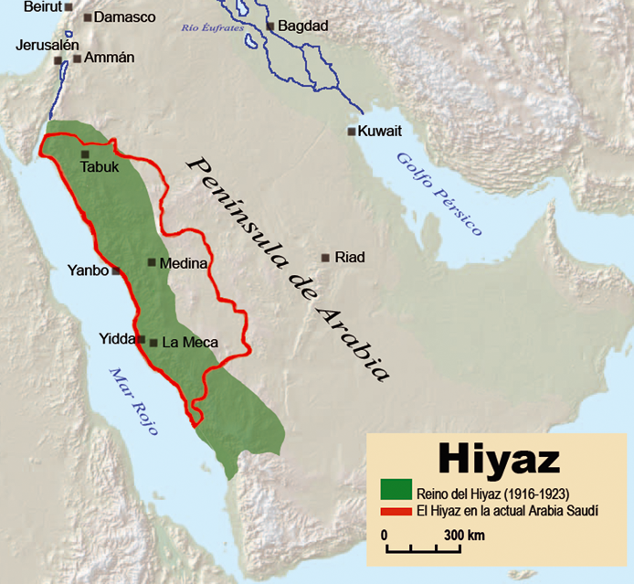

Slide 19
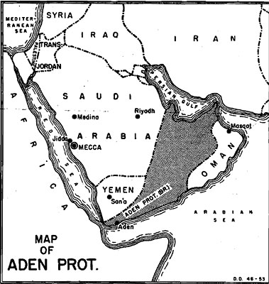

Slide 20
Rome Agreement 1927
Preserve peace among Arab rulers of Eastern shores of Red Sea
Despite this, British thought Italians were encouraging Yemeni incursion beyond frontier with Aden and retaliated with aerial bombings

Slide 21
Revolt in Libya
Emir Muhammad Idris fled to Egypt in 1922
From 1922 to 1928, Italian forces under Badoglio waged a punitive pacification campaign. Badoglio's successor, Rodolfo Graziani, accepted the commission from Mussolini on the condition that he was allowed to crush Libyan resistance.
Omar Mukhtar became leader of the uprising.
Italian policy in Libya reached the level of full scale war.
Soon afterwards, the colonial administration began wholesale deportation to deny the rebels the support of the local population
After Al-Mukhtar's capture September 15, 1931 and his execution, the resistance petered out.
Italian fierce repression strongly criticized in Muslim countries

Slide 22
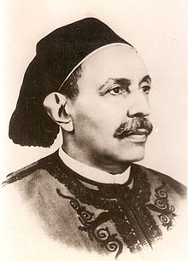

Slide 23
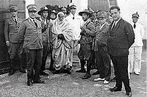

Slide 24
Pro-Arab and Muslim Policy
1933-1934: Mussolini and Fascist hierachies aim at colonial gains in East Africa and Red Sea
Shift in foreign policy: showing respect not only for Middle Eastern countries’ independence, but also for Muslim religion
Origins lay in quarrel with France: Italians believed that Paris was promoting anti-Italian propaganda in Muslim colonies for commercial reasons
Rome decided to set secret centres of philo-Italian propaganda in Muslim countries and strengthen ties with leaders, such as Ibn Saud, as well as showing clemency in Cyrenaica
Mar 18, 1934: address to Party Assembly
Italy as Western Power nearest to Africa and Asia
Natural expansion leading to collaboration with Middle East countries, both material and ideological
Oct 31, 1933 Balbo appointed Governor of Libya: unification of Tripolitania and Cyrenaica with Tripoli as capital and building of facilities. Respect for Muslim traditions, construction and restructure of mosques, repatriation of Cyrenaican exiles

Slide 25
Pro-Muslim propaganda
Arab press suffered from chronic lack of funds
Italians offered financial incentives to several newspapers
Arab press did not turn into fully fledged supporters
Local Middle East press published pro-Italian as well as anti-Italian articles, in order not to antagonise anti-colonialist circles
Great depression brought an image of decadent Western democracies and vigorous Italian authoritarian regime
Crisis extended to Middle East and urban middle class and educated sectors of society suffered from hardships
Boiling mix: economic sufferings, detachment from traditional ways of life, foreign occupation, frustration at corruption of local elites
Fascist and Nazi attracted some adherents

Slide 26
Jewish Nationalism
Ze’ve (Vladimir) Jabotinsky admired Italian culture and had ambiguous approach to Fascism
He quit mainstream Zionist movement in 1923 due to differences of opinion between him and its chairman, Chaim Weizman, and established the new Revisionist Party
His new party demanded that the mainstream Zionist movement recognize as its stated objective the establishment of a Jewish state on both banks of the Jordan River. His main goal was to establish a modern Jewish state with the help and aid of the British Empire
On one hand, he kept contacts with Fascist leaders and managed to have young Jews admitted into maritime school in Civitavecchia
On the other hand, he refused to accept money from Italian government.
He saw Fascist Italy as a counter-balance to British potential overwhelming domination of Zionism, but rejected to put his movement within Rome’s sphere

Slide 27
