Slide 1
Prof. B. Pierri History of Italian Foreign Policy
Fascist Middle Eastern Policy: The First Months of War, Jun-Oct 1940
April 6th, 2016

Slide 2
Holy Land
Transjordan and Palestine to be united in federated monarchy: if not the Italian king, choice among Arab princes
Only Sephardic Jews (Spanish origins) to be incorporated
Jewish emigration stopped, undesirable elements to be expelled and leave room for Arabs, better than Christians
Jewish education system to be de-Zionised

Slide 3
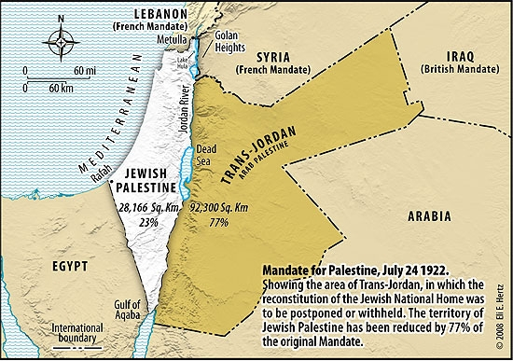

Slide 4
Arab Countries
Syria to become independent republic, giving complete autonomy to region of Druzes and Alawites
Independence subordinate to alliance with Italy, Italian economic domination, Italian military bases, preferential status of Italian language in schools and protection of Christian minorities
Lebanon to receive only mandate-style independence, with Italian commissioner ruling the country
Syria, Lebanon, Palestine, Transjordan, Sinai to form Levant State with a structure like Switzerland and ethnically homogeneous cantons. Everything under Italian mandate

Slide 5
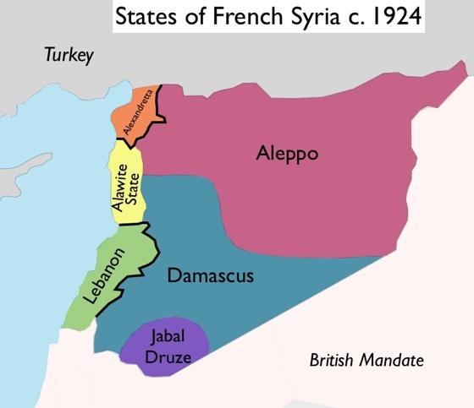

Slide 6
Cyprus
Cyprus under Roman, Venetian, and Genoan domination for 600 years
Italy fought to liberate world from British domination of seas
Three possibilities for Cyprus
Direct Italian domination (preferred)
Autonomy within Italian empire
Union with Greece - this only two weeks before invasion of Greece

Slide 7
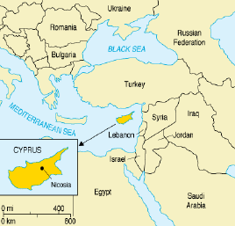

Slide 8
Iraq
Out of Italian zone of influence, as defined by Hitler
In Sept Foreign Ministry recommended Iraq to remain independent and sign mutual defence pact with Italy
Iraq perceived as weak country surrounded by enemies and ethnically disunited
Strong independent Iraq to serve Italian interests
Extension of Iraqi borders at expense of Iran, Kuwait, Syria, Turkey
In return of military protection, Italy to be given oil concessions at that time held by Iraq Petroleum Company

Slide 9
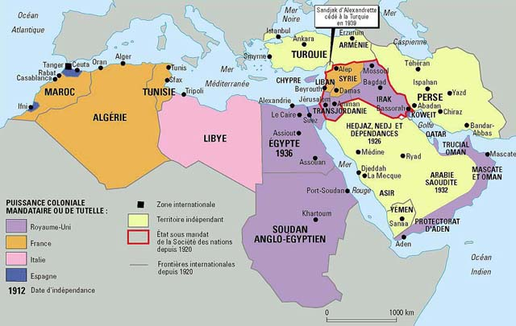

Slide 10
Arabian Peninsula
Aden under direct Italian control
Bahrain under direct Italian control
Yemen and Saudi Arabia independent
Oman to become Italian protectorate
Djibuti under total Italian control

Slide 11
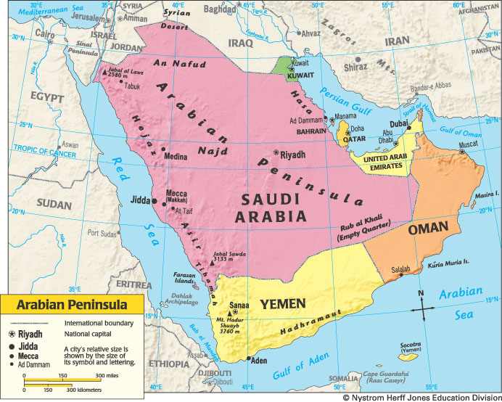

Slide 12
Italo-German-Arab triangle
Oct 23 Joint Italo-German Declaration on Arab Affairs
Axis powers had watched with interest Arab struggle for independence
Arabs could count on Axis simpathy in future
No mention about Arab union of specific countries
Italy did not want any Arab aid, in order not no pay diplomatic price

Slide 13
Italian poor teeth
Bismarck once said that Italy had big appetite, but small teeth
Dec 1940 Hitler expressed similar view:
Failure of Italian campaigns had effect of compressing Italian claims within natural borders of Italian capabilities
Rommel sent to North Africa to salvage Libya from falling in British hands
Italy’s parallel war over

